Slide 1
Introduction to
Cloud Computing and Security
02

Slide 2
What is Cloud Computing?
Cloud computing is the on-demand delivery of IT resources over the Internet with a pay-as-you-go pricing model
Instead of buying, owning, and maintaining physical data centers and servers, you can access technology services such as computing power, storage, and databases on an as-needed basis from a cloud provider

Slide 3
Type of Cloud Computing
Public Cloud
Private Cloud
Hybrid Cloud
Owned and operated by a third-party cloud service provider
Resources are shared with multiple organizations
Example Amazon Web Services (AWS), Microsoft Azure, Google Cloud Platform (GCP)
Dedicated cloud infrastructure for a single organization
Can be on-premises or off-premises
Example Self-managed data center
Combines public and private clouds, allowing data and applications to be seamlessly moved between the two ones
Provides flexibility and enhanced security

Slide 4
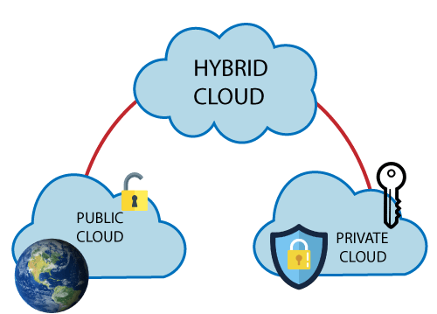
Type of Cloud Computing

Slide 5
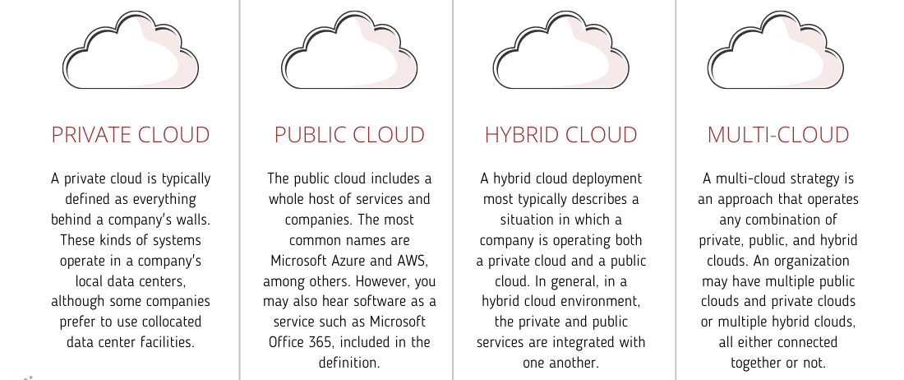
Four Cloud Options

Slide 6
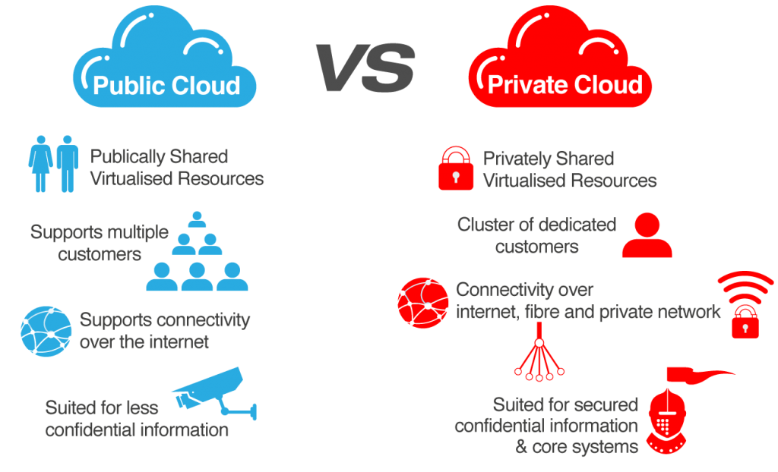
Public vs Private

Slide 7
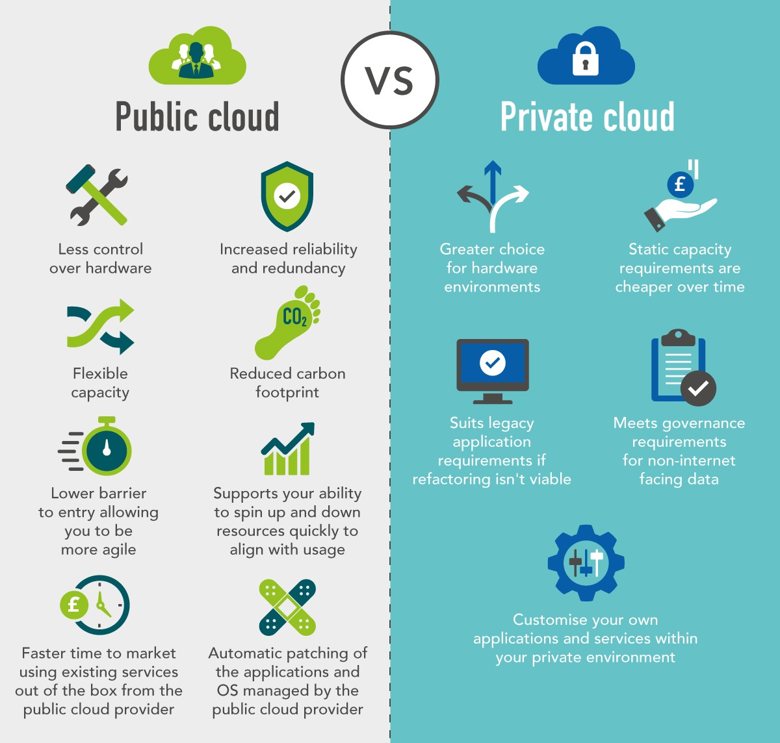
Public vs Private

Slide 8
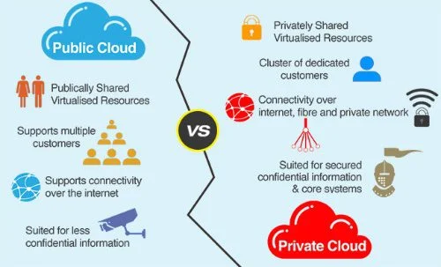
Public vs Private

Slide 9
Benefits of Cloud Computing
Cost-Effective pay only for the resources you use
Scalability easily scale resources up or down to meet changing demands
Reliability high availability and disaster recovery capabilities
Performance improved performance and faster innovation
Security robust security measures to protect data
Flexibility access resources from anywhere with an internet connection

Slide 10
The Shared Responsibility Model
A framework defining security responsibilities between a Cloud Service Provider (CSP) and its customers
It's a collaborative approach where both parties play crucial roles in ensuring the security of cloud environments

Slide 11
Cloud Service Provider's Responsibilities
Physical and Environmental Security
Network and Infrastructure Security
System and Application Security
Securing data centers, hardware, and network infrastructure
Implementing physical access controls, environmental controls, and disaster recovery plans
Protecting the underlying network and infrastructure components
Implementing firewalls, intrusion detection systems, and other security measures
Ensuring the security of the cloud platform and underlying services
Patching, updating, and securing operating systems and applications

Slide 12
Customer's Responsibilities
Customer Data
Operating Systems, Applications, and Data
User Access and Identity Management
Protecting sensitive data stored and processed in the cloud
Implementing encryption, access controls, and data loss prevention measures
Securing operating systems, applications, and data deployed on cloud infrastructure
Applying security patches, configuring firewalls, and implementing strong password policies
Managing user identities and access privileges to cloud resources
Implementing multi-factor authentication and role-based access control

Slide 13
Shared Responsibilities
Logging and Monitoring
Both the CSP and customer share responsibility for logging and monitoring activities
The CSP provides logging and monitoring tools, while the customer configures and analyzes logs
Incident Response
Both parties collaborate on incident response planning and execution
The CSP provides incident response capabilities, while the customer is responsible for incident detection and reporting

Slide 14
Understanding the Shared Responsibility Model
Across Different Cloud Service Models
Infrastructure as a Service (IaaS)
Platform as a Service (PaaS)
Software as a Service (SaaS)
Highest level of customer responsibility
Customers manage operating systems, applications, and data
Shared responsibility between CSP and customer
CSP manages the platform, while customers manage applications and data
Lowest level of customer responsibility
CSP manages the entire application stack, including infrastructure, platform, and application

Slide 15
Remarks
The Shared Responsibility Model is essential for ensuring the security of cloud environments
By understanding the roles and responsibilities of both the CSP and customer, organizations can effectively mitigate risks and protect their data and applications
Collaboration and communication between the CSP and customer are key to successful implementation of the Shared Responsibility Model

Slide 16
Benefits of Cloud Computing
Stay informed keep up-to-date with the latest security best practices and threats
Leverage cloud provider security tools: utilize the security tools and services provided by your CSP
Regularly review and update security policies and procedures
Conduct security audits and penetration testing
Train employees on security awareness and best practices

Slide 17
Key Security Challenges
The Security Dilemma while the cloud offers immense advantages, it also introduces new security challenges

Slide 18
Challenge 1 – Data Breaches
Threat Landscape
Cloud-Specific Vulnerabilities
Mitigation Strategies
Increasing frequency and sophistication of data breaches
Misconfigurations accidental exposure of sensitive data due to incorrect settings
Weak Access Controls: inadequate authentication and authorization mechanisms
Insecure APIs exploitable vulnerabilities in APIs
Implement strong access controls multi-factor authentication, role-based access control
Regular security audits and vulnerability assessments
Data encryption protect data at rest and in transit
Incident response planning develop a robust plan to respond to data breaches

Slide 19
Challenge 2 – Unauthorized Access
Insider Threats
External Threats
Employees with malicious intent can compromise sensitive data
Hackers and cybercriminals constantly seek vulnerabilities
Cloud-Specific Risks
Mitigation Strategies
Weak password policies easily guessable passwords
Phishing attacks tricking users into revealing credentials
Social engineering manipulating users to gain unauthorized access
Employee awareness training educate employees about security best practices
Strong password policies enforce complex password requirements
Intrusion detection and prevention systems monitor network traffic for suspicious activity
Regular security audits and penetration testing

Slide 20
Challenge 3
DDoS Attacks
Impact on Cloud Services
Mitigation Strategies
Overwhelm systems with traffic, rendering them inaccessible
Disrupted services impaired availability and performance
Reputational damage negative impact on brand and customer trust
Financial losses lost revenue and increased operational costs
Robust DDoS protection solutions employ advanced mitigation techniques
Network traffic filtering identify and block malicious traffic
Cloud provider's security features leverage built-in DDoS protection capabilities
Incident response plan to quickly mitigate the impact of DDoS attacks

Slide 21
Remarks
Importance of Proactive Security
Collaboration and Best Practices between cloud providers, security vendors, and organizations
Staying Informed encourage continuous learning and adaptation to evolving threats

Slide 22
The Need for Strong Network Security
The Digital Age
Rapid digitization of information
Increased reliance on technology
Growing threat landscape
The Need for Strong Network Security
Protecting sensitive data
Maintaining business continuity
Complying with regulations

Slide 23
Understanding the Threat Landscape
Cyber Threats
Malware attacks
Phishing scams
Ransomware
DDoS attacks
Data breaches
The Rising Stakes
Financial loss
Reputation damage
Legal repercussions

Slide 24
Data in Transit and at Rest
Data in Transit
Data moving across networks
Vulnerable to interception and manipulation
Data at Rest
Data stored on devices and servers
Target of unauthorized access and theft

Slide 25
Key Security Measures
Secure Access Control
Firewalls
Implementing strong authentication and authorization
Limiting access to sensitive data
Regular Security Audits and Penetration Testing:
Identifying vulnerabilities and weaknesses
Implementing corrective measures
Filtering network traffic
Preventing unauthorized access
Encryption
Converting data into unreadable code
Protecting data both in transit and at rest
Intrusion Detection Systems (IDS)
Regular Security Audits and Penetration Testing
Monitoring network traffic for suspicious activity
Detecting and alerting on potential threats
Identifying vulnerabilities and weaknesses
Implementing corrective measures

Slide 26
Best Practices for Strong Network Security
Employee Training and Awareness
Regular Patch Management
Educating employees about security threats and best practices
Promoting a security-conscious culture
Keeping software and systems up-to-date
Addressing vulnerabilities promptly
Incident Response Plan
Data Backup and Recovery
Having a plan in place to respond to security incidents
Minimizing damage and restoring operations
Protecting data from loss or corruption
Enabling quick recovery in case of a breach

Slide 27
Remarks
The Importance of Proactive Security
A Collaborative Approach
Safeguarding Your Digital Future
Investing in strong network security is essential
Staying ahead of evolving threats
Working with IT teams and security experts
Implementing a layered security strategy
Protecting your organization's valuable assets
Building a resilient and secure digital infrastructure

Slide 28
The Importance of a Robust Security Strategy
In today's digital age, the cloud has become an indispensable tool for businesses of all sizes
It offers scalability, flexibility, and cost-effectiveness, enabling organizations to innovate and grow at an unprecedented pace
However, with these benefits comes a new set of challenges, particularly in the realm of security
As more and more sensitive data migrates to the cloud, the need for a robust security strategy becomes paramount

Slide 29
Understanding the Cloud Security Landscape
Shared Responsibility Model
Common Cloud Security Threats
Denial-of-service (DoS) attacks
Cloud providers are responsible for securing the infrastructure
Organizations are responsible for securing their data and applications
Data breaches
Malware attacks
Misconfigurations
Insider threats

Slide 30
Building a Secure Cloud Foundation
Strong Identity and Access Management (IAM)
Data Encryption
implement strong password policies and multi-factor authentication (MFA).
Grant least privilege access to resources.
Regularly review and revoke access permissions.
Encrypt data both at rest and in transit.
Use industry-standard encryption algorithms.
Network Security
Regular Security Assessments
Utilize firewalls, intrusion detection systems (IDS), and intrusion prevention systems (IPS).
Segment networks to limit the impact of potential breaches.
Conduct regular vulnerability assessments and penetration testing.
Stay updated on the latest security threats and patches.
Incident Response Plan
Employee Training and Awareness
Develop a comprehensive incident response plan.
Test the plan regularly to ensure its effectiveness.
Educate employees about security best practices.
Conduct regular security awareness training.

Slide 31
Best Practices for Secure Cloud Environment
Choose a Reputable Cloud Provider select a provider with a strong security track record
Stay Updated with Security Patches regularly apply security patches to your cloud infrastructure
Monitor and Log Activity continuously monitor your cloud environment for suspicious activity.
Implement Security Automation automate security tasks to improve efficiency and reduce human error.
Collaborate with Security Experts seek expert advice to strengthen your security posture.

Slide 32
Remarks
By adopting a proactive and comprehensive security strategy, organizations can mitigate risks and protect their valuable assets in the cloud
A secure cloud foundation is essential for building trust with customers and partners.
Remember, security is not an afterthought; it should be an integral part of your cloud journey from the very beginning

